Slide 1
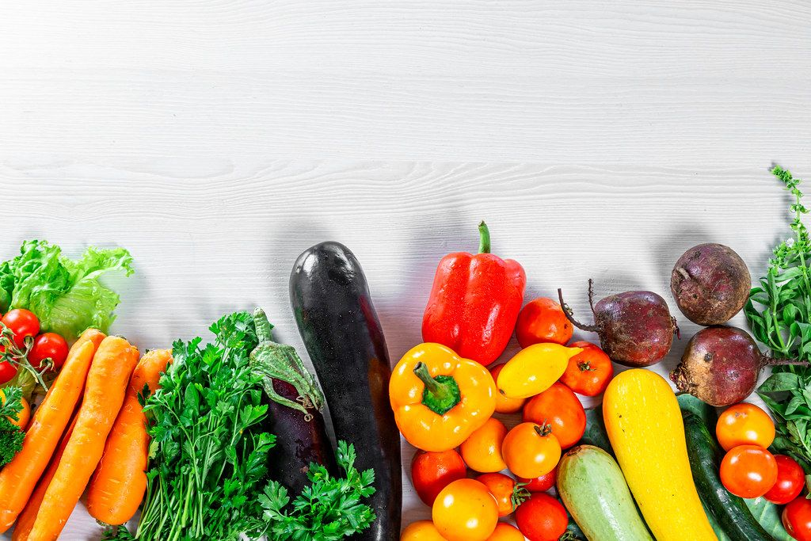
Mini Project
FARMERS CART APP
This Photo by Unknown Author is licensed under CC BY

Slide 2
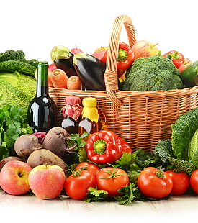
TEAM MEMBERS
Anisha Shahini. D (950019104002)
Jeba Salomi. D (950019104016)
Maliga Fathima Rowfina. S (950019104025)
Maria Rexline. R (950019104027)
GUIDE NAME
Mrs. T. KAVITHA
ASSISTANT PROFESSOR
DEPARTMENT OF COMPUTER SCIENCE
ANNA UNIVERSITY REGIONAL CAMPUS - TIRUNELVELI

Slide 3

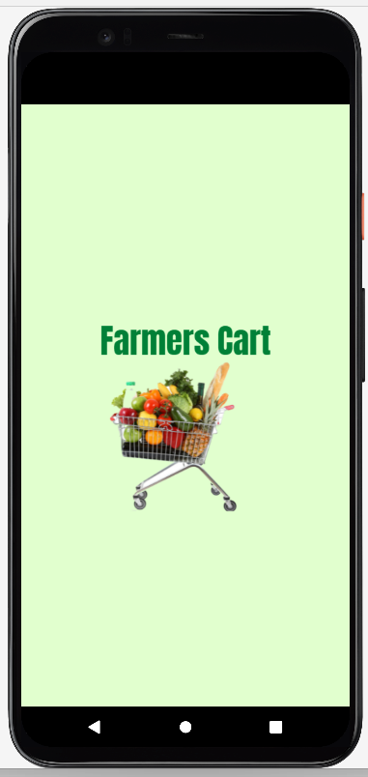
INTRODUCTION
Farmers cart app is an android application which serves as an interface between farmers and retailers or customers.
This application helps farmers to sell their products directly to customer without any intermediate agents.
This application helps the farmers to sell their products online from their own locality.

Slide 4
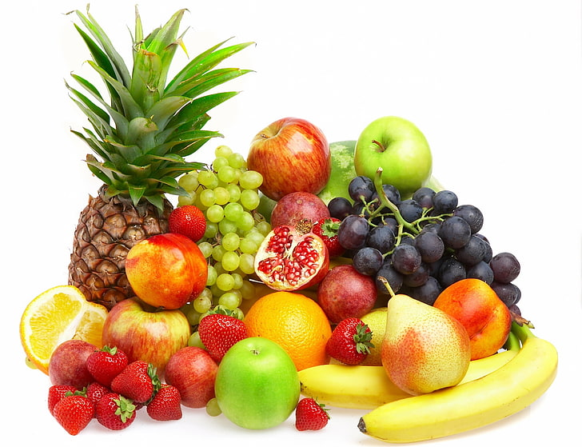
OBJECTIVE
To help the farmers, Farmers Cart app is used to gain profit price by cutting the middlemen.
To help the customer, this application used to buy quality products in their own locality

Slide 5
LITERATURE SURVEY
AGRI APP- SMART FARMING APP:
ADVANTAGES:
This app gives complete information about crop production,
crop protection, smart farming etc..
The app consists of new technology like soil testing, crop advisory and crop practice.
DISADVANTAGES:
The user interface of this app is old fashioned and show some error during login.
This app sometimes does not show some product details and some market details.

Slide 6
BIG HAAT-SMART FARMING APP:
ADVANTAGES:
This app gives useful solution to crop related problems and where user can buy all crop related products at one place.
This app provide good quality seeds at the door step.
DISADVANTAGES:
In this app, the products are very costly than outside market and some products are about to expire and such items are in home page.

Slide 7
AGRI BEGRI :
ADVANTAGES:
This application is easy to use and product rates are affordable.
This application has very convenient and useful farmer friendly service.
DISADVANTAGES:
Search option is very poor in this application.
This app gives only 4 hours time to return the purchased products.

Slide 8
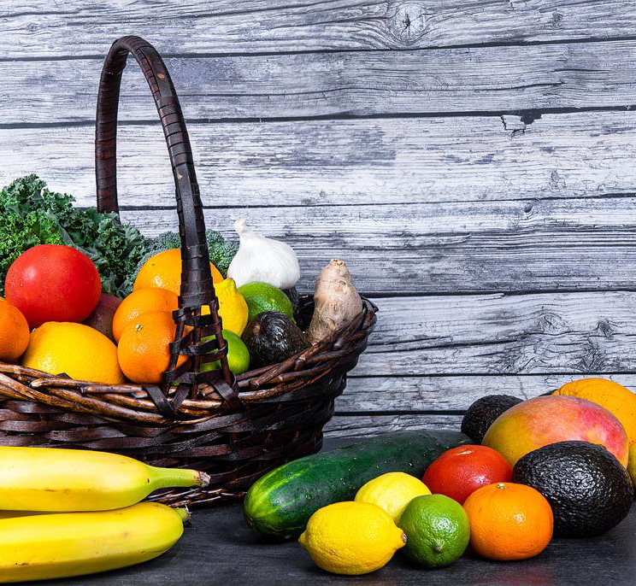
PROBLEM DEFINITION
Most of the farmers in India are smallholder farmers who only typically 1-2 hectares of farmland.
These smallholder formers suffer a lot to sell their small amount of farm products to distant location.
So the most of the profits are taken by the middle agents that the farmers face lot of loss in their field.
Faster technology adoption will enable farmers, especially smallholder farmer.
It will provide a framework for future dealing with selling their products.

Slide 9

REQUIREMENT SPECIFICATION
Hardware
64 bit
8GB RAM or more
Software
Window OS
Android studio
8GB of available disk space minimum (IDE + Android SDK + Android Emulator)
1280*800 minimum screen resolution.

Slide 10
MODULES WITH EXPLANATION
REGISTRATION MODULE
Registration for user and farmer
Login
FARMER MODULE
Product Details
Sales Details
USER MODULE
Cart Details
Order Details

Slide 11
REGISTRATION MODULE
REGISTRATION FOR USER AND FARMER:
This function contains registration page for both user and farmer in order to get information of user and farmer. These details are stored in database.
LOGIN:
This function contains login page which contains email and password in which already registered user and farmer can login through this page. The other modules are followed by this login page.

Slide 12
FARMER MODULE
PRODUCT DETAILS:
This function allows the farmer to add their products with details. These details are stored in database under products title and showed to the farmer in their profile.
SALES DETAILS:
This function contain sales page in which product once ordered by user are stored in database under order title and updated in the farmers sales page.

Slide 13
USER MODULE
CART DETAILS:
This function contains cart page in which user once choose the product to purchase is added to the cart with product details.
ORDER DETAILS:
This function contains order page in which user can view their order status when the user confirm the product to purchase.

Slide 14
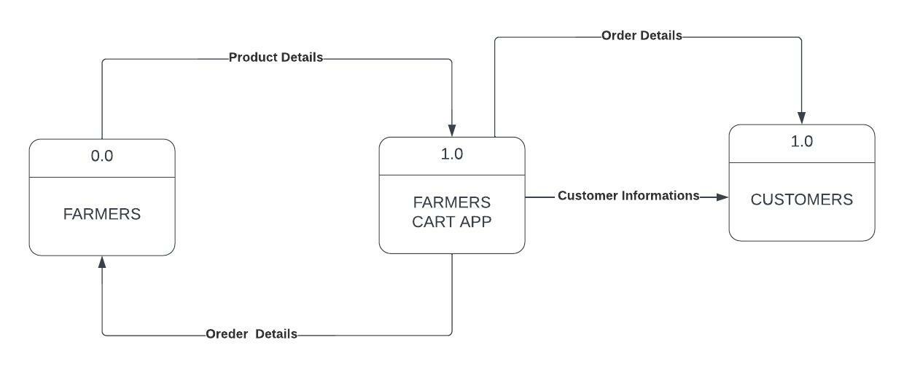
SYSTEM DESIGN
DFD – LEVEL 0

Slide 15
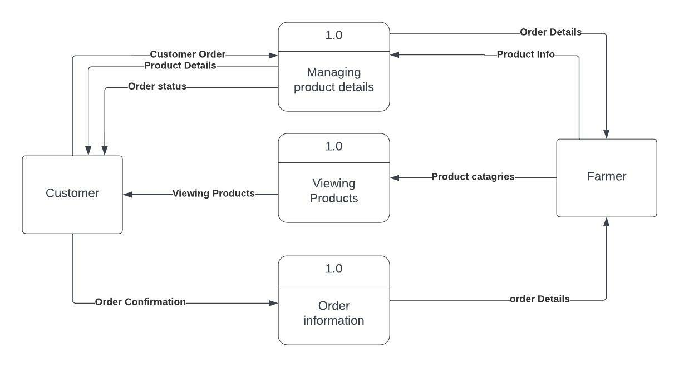
DFD – LEVEL 1

Slide 16
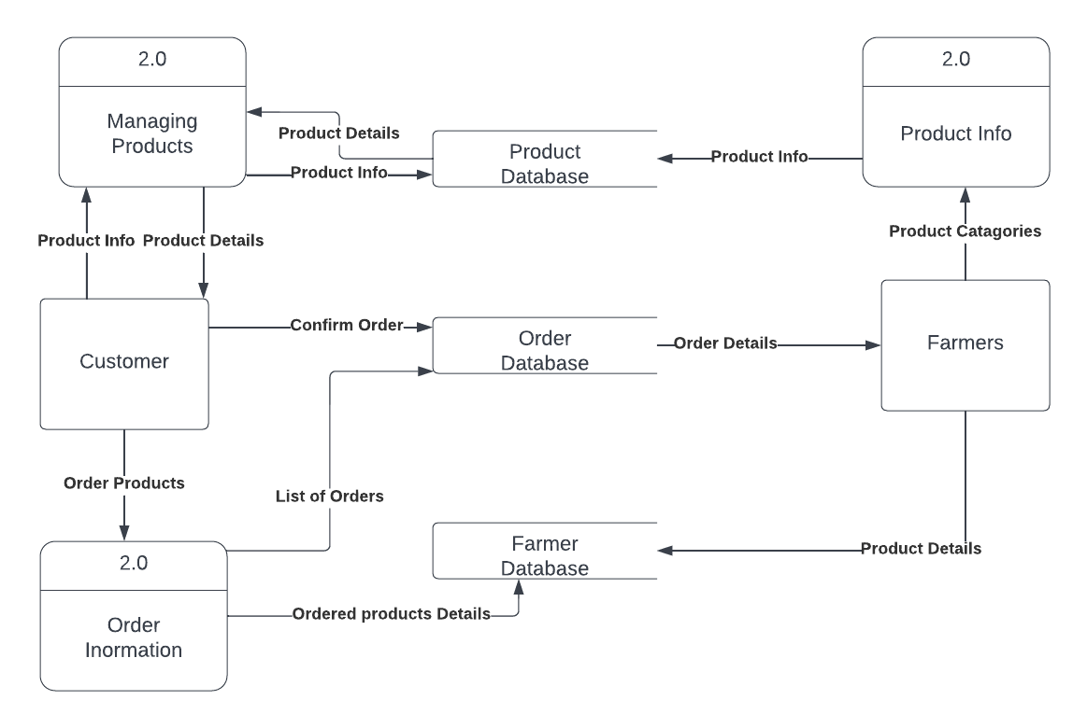
DFD – LEVEL 2

Slide 17
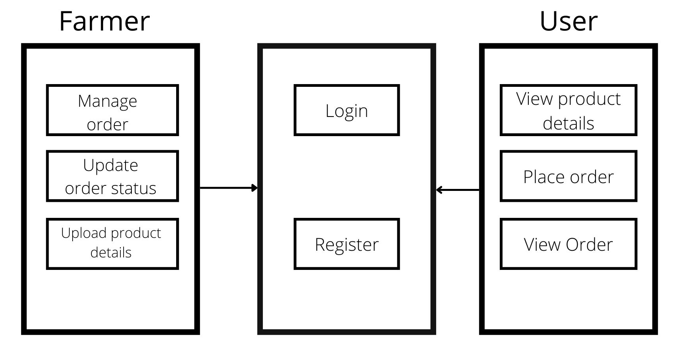
ARCHITECTURE DIAGRAM

Slide 18
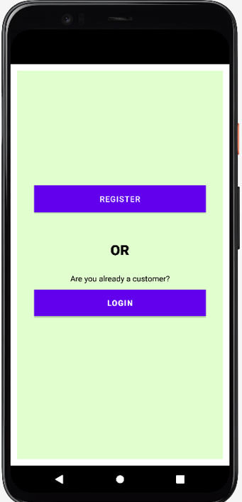
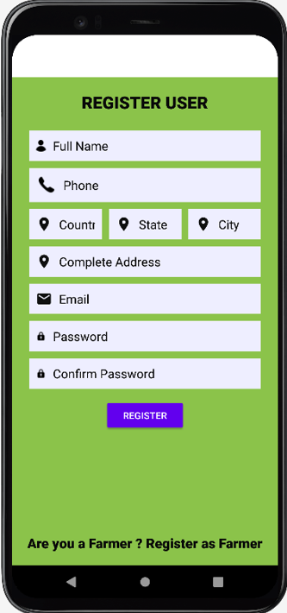
100% COMPLETION AND ITS ASSOCIATED RESULT

Slide 19
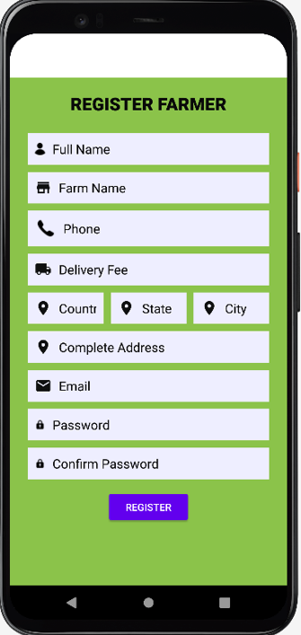
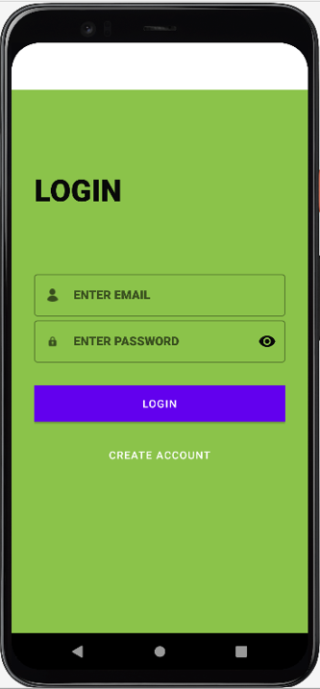
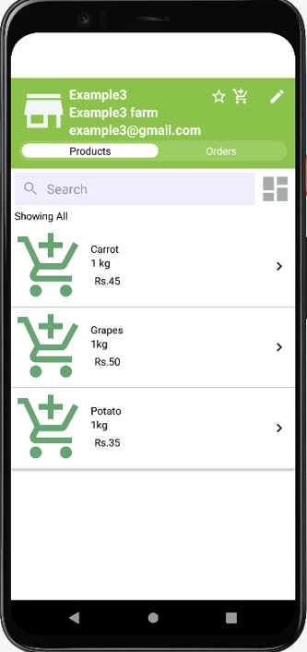
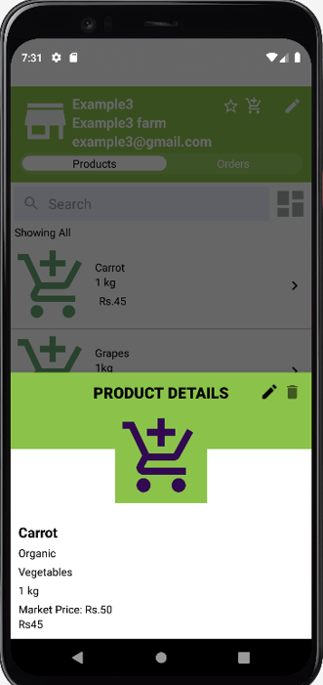

Slide 20
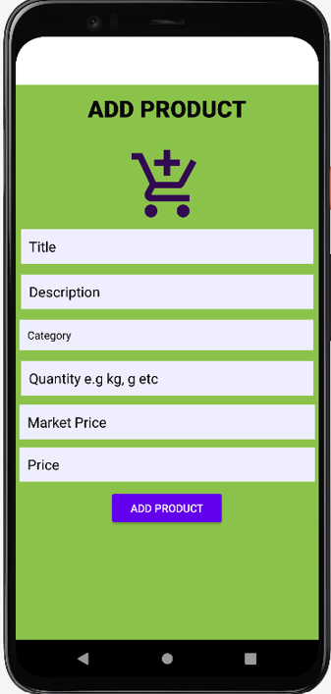
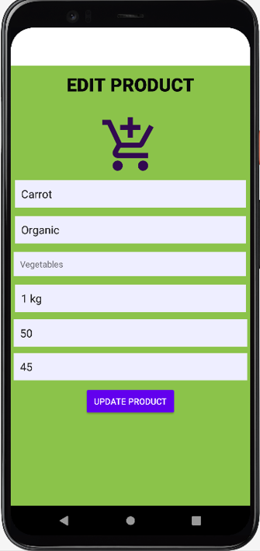
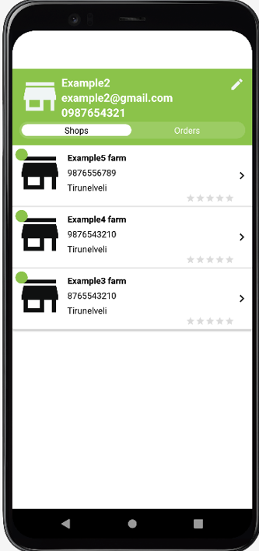
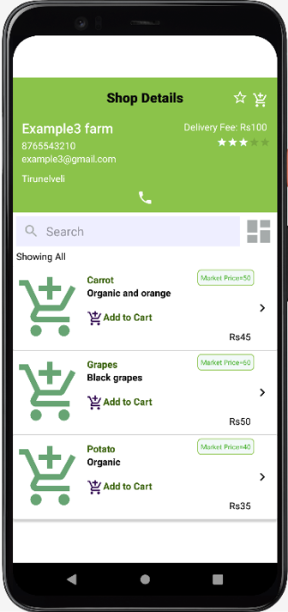

Slide 21
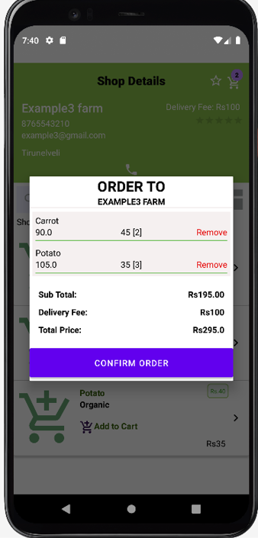
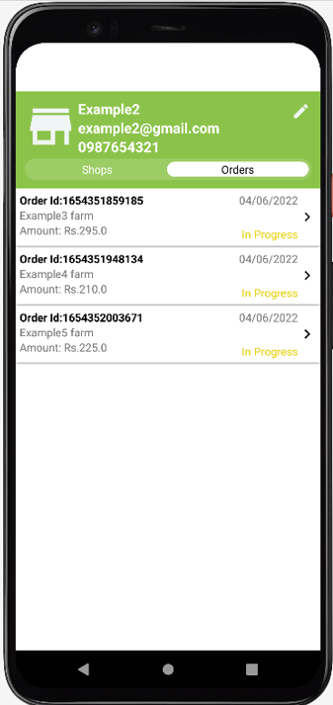
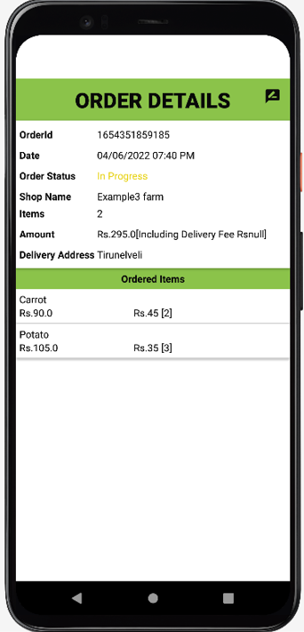
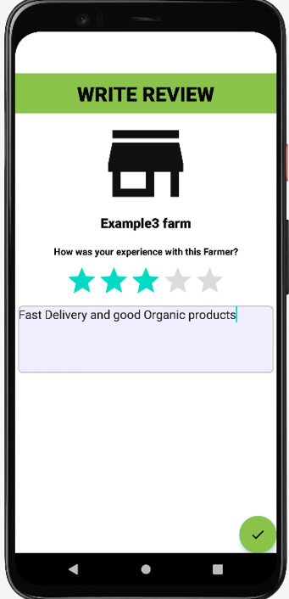

Slide 22
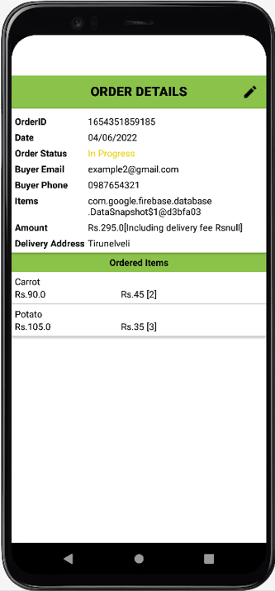
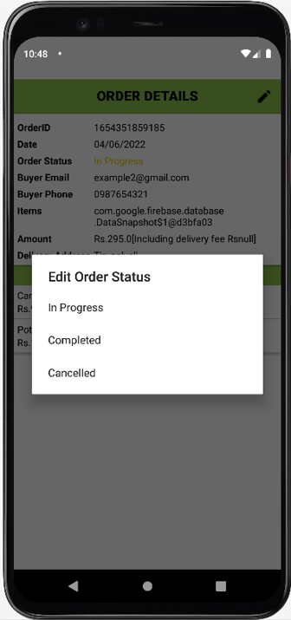

Slide 23
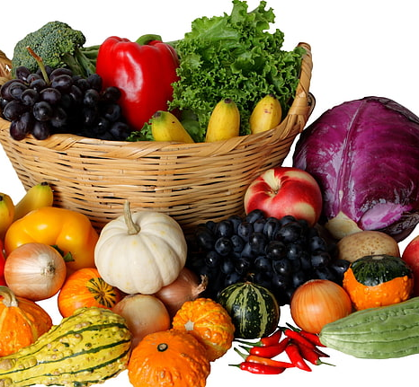
CONCLUSION
The proposed system is internet based system.
In this system, the farmers can upload their products details and users can view and order the products.
This system allow the farmer to sell their farm products without any middlemen

Slide 24
REFERENCES
https://codeshoppy.com/shop/product/agri-shop-for-farmers/
https://developer.android.com/docs
AgriApp - https://play.google.com/store/apps/details?id=com.criyagen
Bighaat - https://play.google.com/store/apps/details?id=com.BigHaat
AgriBegri - https://play.google.com/store/apps/details?id=com.agribegri

Slide 25
THANK YOU

